Slide 1
Face Recognition with MTCNN
- Amit Kumar

Slide 2
Contents
Face recognition pipeline
What is MTCNN
MTCNN – Architecture
Stage 1: P-Net
Stage 2: R-Net
Stage 3: O-Net
MTCNN Implementation
MTCNN – Loss Function
Code Demo

Slide 3
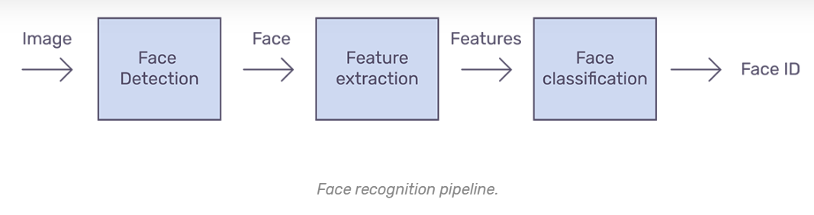
Face recognition pipeline
Face detection - Detecting one or more faces in an image
Feature extraction - Extracting the most important features from an image of the face
Face classification - Classifying the face based on extracted features
Source Credit: https: //arsfutura.co/magazine/face-recognition-with-facenet-and-mtcnn/

Slide 4
What is MTCNN
MTCNN is Multi-task Cascaded Convolutional Networks
MTCNN is an algorithm with 3 stages, in which the bounding boxes of faces in an image along with their 5 Point Face Landmarks are detected
It uses three sequential networks : P-Net,R-Net,O-Net to detect face(s) in image
P-Net : This is the Proposal Network that proposes candidate facial regions
R-Net : Refine Network filters the bounding boxes around the facial regions
O-Net : Output Network proposes facial landmarks(left eye, right eye, nose, left mouth corner and right mouth corner)

Slide 5
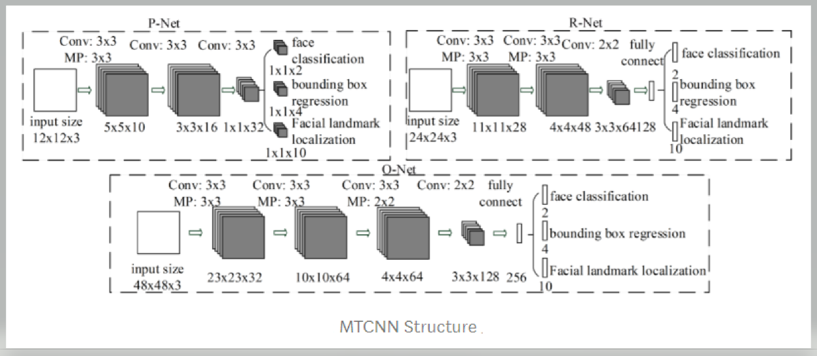
MTCNN - Architecture
Source Credit:https://arxiv.org/ftp/arxiv/papers/1604/1604.02878.pdf

Slide 6
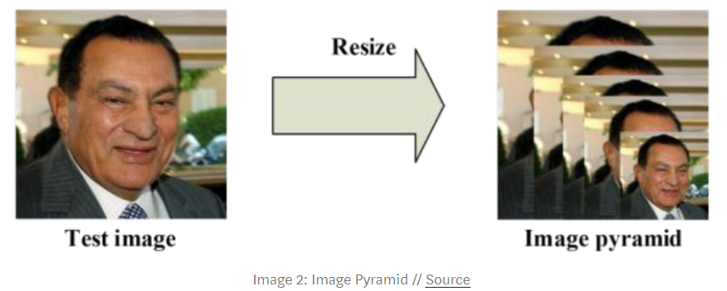
Stage 1: P-Net
P-Net is the Proposal Network mainly employed to get the bounding boxes around face
The input image is resized into multiple small images known as image pyramid (different copies of same image in different sizes are created to search for different sized faces within the image)
Source Credit:https://arxiv.org/ftp/arxiv/papers/1604/1604.02878.pdf

Slide 7
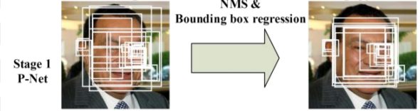
Stage 1: P-Net
The scaled copy is passed through 12 x 12 stage 1 kernel that traverse through every part of the image, scanning for faces
The output is then sent to P-Net, which returns the coordinates of a bounding box if it notices a face
The same process is repeated after taking strides and applying the kernel to the scaled copy
Source Credit:https://arsfutura.co/magazine/face-recognition-with-facenet-and-mtcnn/

Slide 8
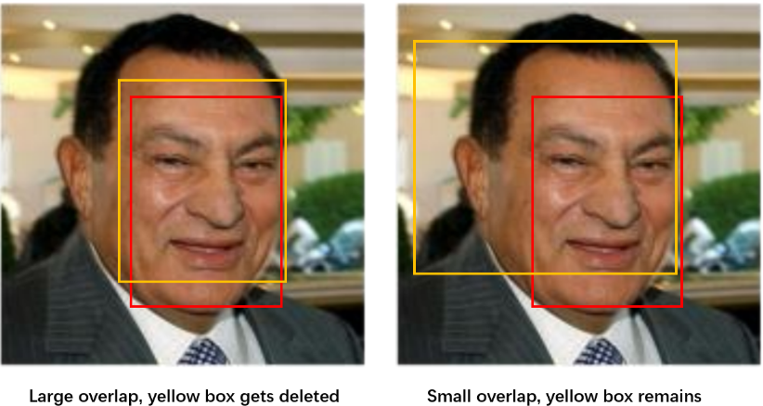
Stage 1: P-Net
The weights & biases for a P-Net are trained to output accurate boundary boxes for each kernel
P-Net provide confidence level for the bounding boxes ,based upon which lower confidence level bounding boxes are removed
Non-Maximum Suppression or NMS is applied that further reduces the number of bounding boxes
As part of NMS, the kernels that overlap a lot with the high-scoring kernel get deleted
Source Credit:https://towardsdatascience.com/how-does-a-face-detection-program-work-using-neural-networks-17896df8e6ff

Slide 9
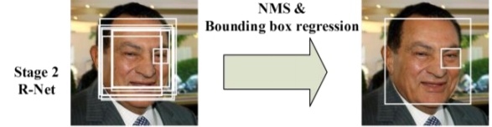
Stage 2: R-Net
R-Net is the Refine Network
R-Net outputs the coordinates of the new, more accurate bounding boxes, as well as the confidence level of each of these bounding boxes. In this respect, R-Net’s output is similar to that of P-Net
R-Net also employs NMS to further eliminate redundant boxes
Source Credit:https://arxiv.org/ftp/arxiv/papers/1604/1604.02878.pdf

Slide 10
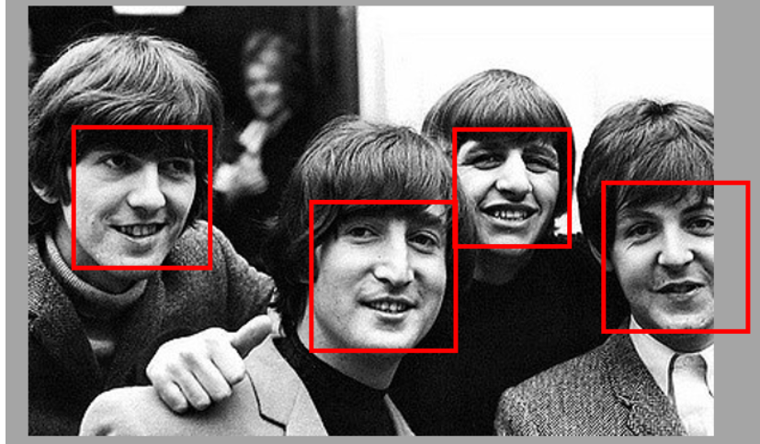
Stage 2: R-Net
If a face is not visible completely as in the below image , then the particular area is zero padded(in the array) for the section of the face not present in the image
Source Credit:https://towardsdatascience.com/how-does-a-face-detection-program-work-using-neural-networks-17896df8e6ff

Slide 11
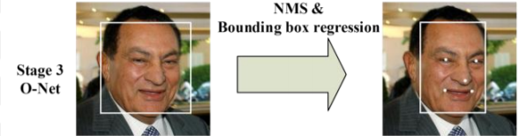
Stage 3: O-Net
O-Net is the Output Network
O-Net provides 3 outputs: the coordinates of the bounding box, the coordinates of the 5 facial landmarks and the confidence level of each box
O-Net also employs NMS to further eliminate lower confidence level bounding boxes
Source Credit:https://arxiv.org/ftp/arxiv/papers/1604/1604.02878.pdf

Slide 12
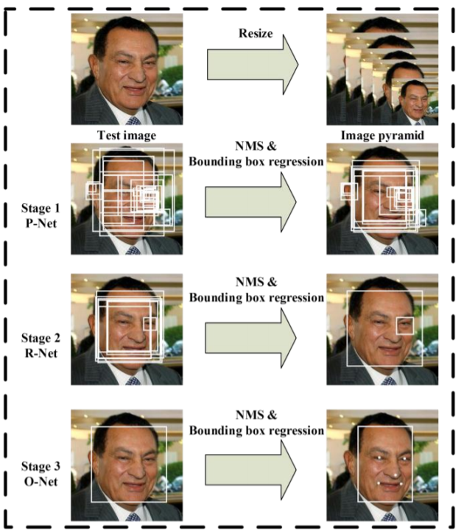
MTCNN Implementation
Below figures displays a stagewise implementation of MTCNN on a facial image
Source Credit:https://arxiv.org/ftp/arxiv/papers/1604/1604.02878.pdf

Slide 13





MTCNN – Loss Function
For face classification , cross entropy loss is calculated as:
Here, is the cross-entropy loss, is the probability produced by the network
that indicates a sample being a face, denotes ground truth
For bounding box regression, Euclidean loss for each sample is calculated as:
Here, is the regression target obtained from the network, is the ground
truth coordinate
Source Credit:https://arxiv.org/ftp/arxiv/papers/1604/1604.02878.pdf

Slide 14




MTCNN – Loss Function
For facial landmark detection, Euclidean loss is minimized as:
Here, is the facial landmark coordinate obtained from the network,
is the ground truth coordinates
The overall learning target is formulated as:
Here, is the number of samples, denotes the task importance, is the
sample type indicator
Source Credit:https://arxiv.org/ftp/arxiv/papers/1604/1604.02878.pdf

Slide 15

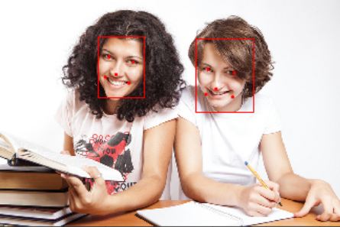
Code Demo
In this code, we have used two photographs as input image,test1.jpg which has two college students and the test2.jpg which has 5 cricketers in one frame.
We get successful output as listed below:

Slide 16

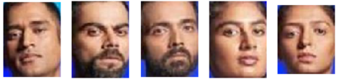
Code Demo

Slide 17
Thank You

